Slide 1
Week 07: Loops CS 110 - Introduction to Programming
Brother W. Clements

Slide 2

Prepare
Kahoot Quiz: None

Slide 3

Prepare
Questions about
Infinite vs Finite
Collections – intro more week 9-10
Current: Boolean(True/False) < int < float & string
Array - numeric, same type
[] – list: order: append, insert, sort,
{} – dictionary: no-order
Loops
Exit strategy, container
For var in […] @[]-list
Array
range
While (<condition>)
Must change the condition - exit, or stack overflow
len
When to use?
For: I know the beginning and end – finite
While: I don’t know when it will end – infinite
Nesting loops
Method | Lists Description
append() | Adds an element at the end of the list
clear() | Removes all the elements from the list
copy() | Returns a copy of the list
count() | Returns the number of elements with the specified value
extend() | Add the elements of a list (or any iterable), to the end of the current list
index() | Returns the index of the first element with the specified value
insert() | Adds an element at the specified position
pop() | Removes the element at the specified position
remove() | Removes the item with the specified value
reverse() | Reverses the order of the list
sort() | Sorts the list

Slide 4
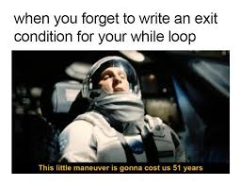
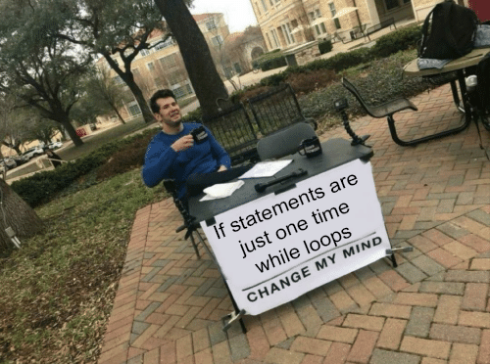
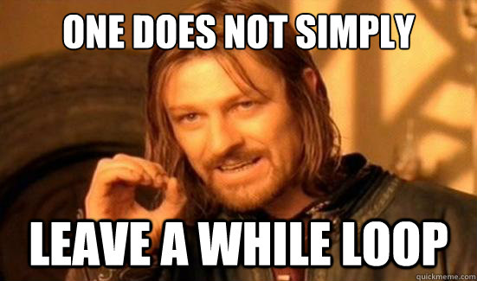
Lecture
See Classroom example
Containers
Default Conversion
Lists: strings, array, range
Dictionary
For
While
Using debug flags
Conversion of values
Other Cans of Nothing
Empty cans of cans of nothing
Defining keys
Working with “ vs ‘ or using variable instead
Formatting a list of values to output
Having an exit plan
Working with multiple input
Nested loops

Slide 5

Checkpoint
colors = ["red", "blue", "green", "yellow"]
red
blue
green
Yellow
1
2
3
4
5
6
7
8
May I have a piece of candy? no
May I have a piece of candy? no
May I have a piece of candy? no
May I have a piece of candy? no
May I have a piece of candy? yes
Thank you.
Steps
Read instructions -
Demonstrate your understanding of loops by completing the following individual checkpoint assignment.
Attempt coding the problem for 1 hour
For: colors, numbers,
While: prompt
Test:
Colors appear
1 not 0
8 not 7
Yes the 1st time.
Look at the Instructor code after 1 hour or when done.
Include in notes, what you learned from the instructor's code

Slide 6

Teach: Team Activity List of Numbers
Meet and setup a video call, share screen
Overview
In the Guess My Number game the computer picks a magic number, and then the user tries to guess it. After each guess, the computer tells the user to guess "higher" or "lower" until they guess the magic number.
Core requirements
Having the computer pick a random number
Loop until number is guessed
import random
number = random.randint(1, 10)
Stretch Challenge
Track number of guesses
End on yes
Teacher Solution
Submission
In notes tell me what you learned from the teacher solutions.
What is the magic number? 6
What is your guess? 4
Higher
What is the magic number? 6
What is your guess? 7
Lower
What is the magic number? 6
What is your guess? 6
You guessed it!

Slide 7
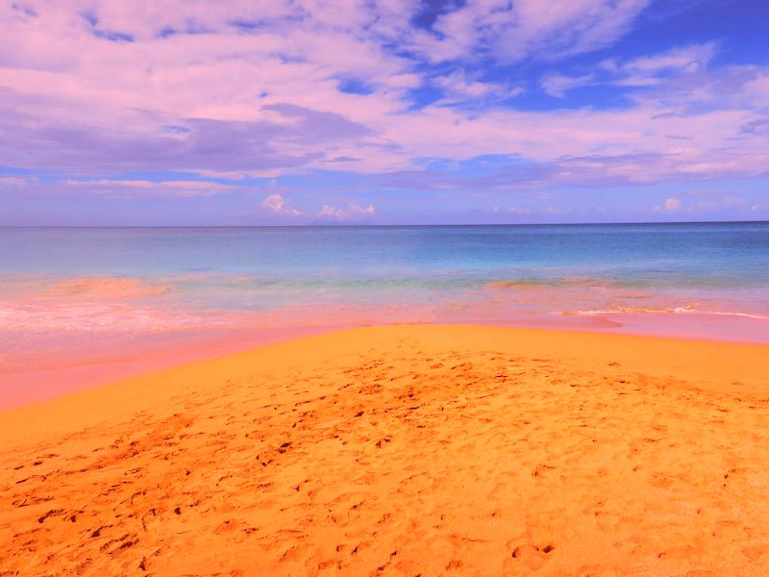

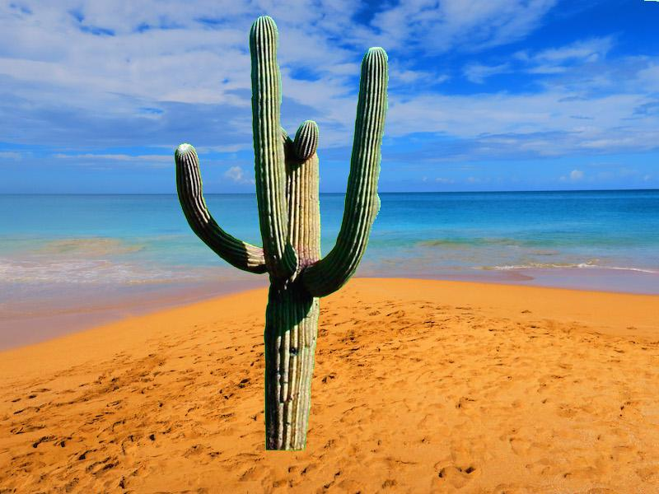
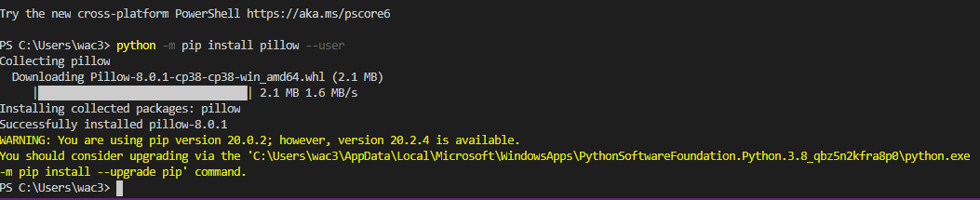
Prove (Milestone)
Overview
A digital image is composed of a number pixels arranged in a grid. Each of these pixels is a color that can be represented as a red, green, and blue (RGB) value. These values range from 0 to 255 for each of the red, green, and blue components. So if a pixel had a red value of 255, and a green value of 0, and a blue value of 255, it would appear as one bright purple dot (mix of red and blue) in the picture.
Program the following:
Read the whole assignment, watch videos
Download and save image file (recommend creating a folder for all this)
Install python library
Open image files in program
Iterate through pixels
Use if statement for decision
Produce new image
Milestone
Library working, open image, add red pixels, display image.
Make sure you are in the right directy, cd (use tabs to auto complete)
Make it your own
Creative: You could consider adding better formatting (for example, aligning the prices), storing extra information, such as the quantity of the items in the list, or you can add anything else you think of to make the shopping cart better.
Milestone: Submission
When the Milestone is complete, answer the questions in the associated quiz in I-learn.

Slide 8
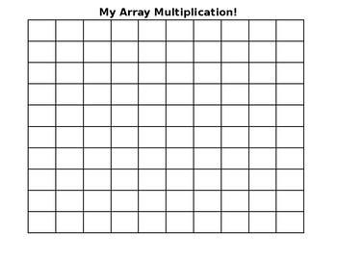
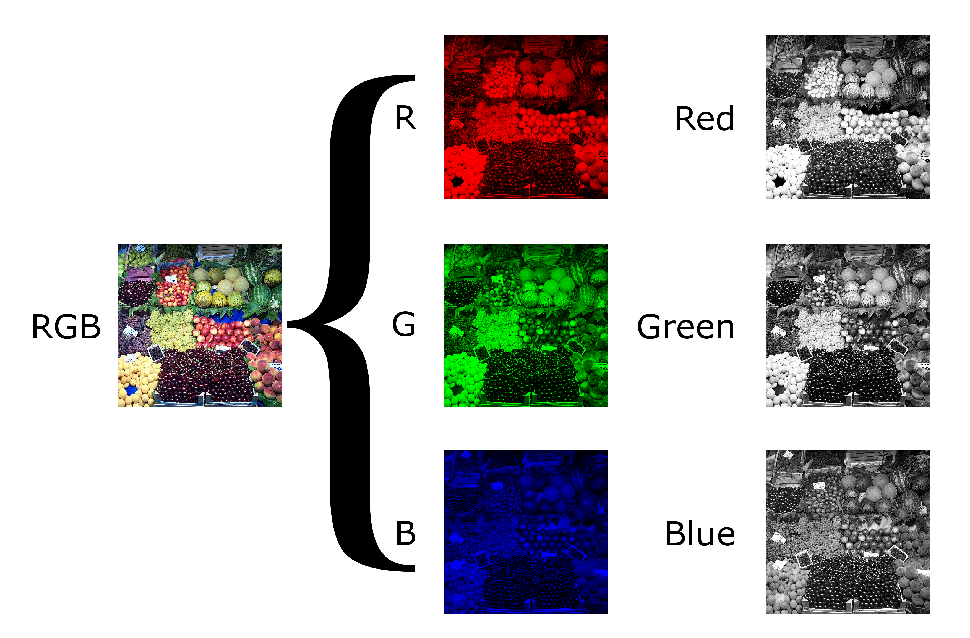
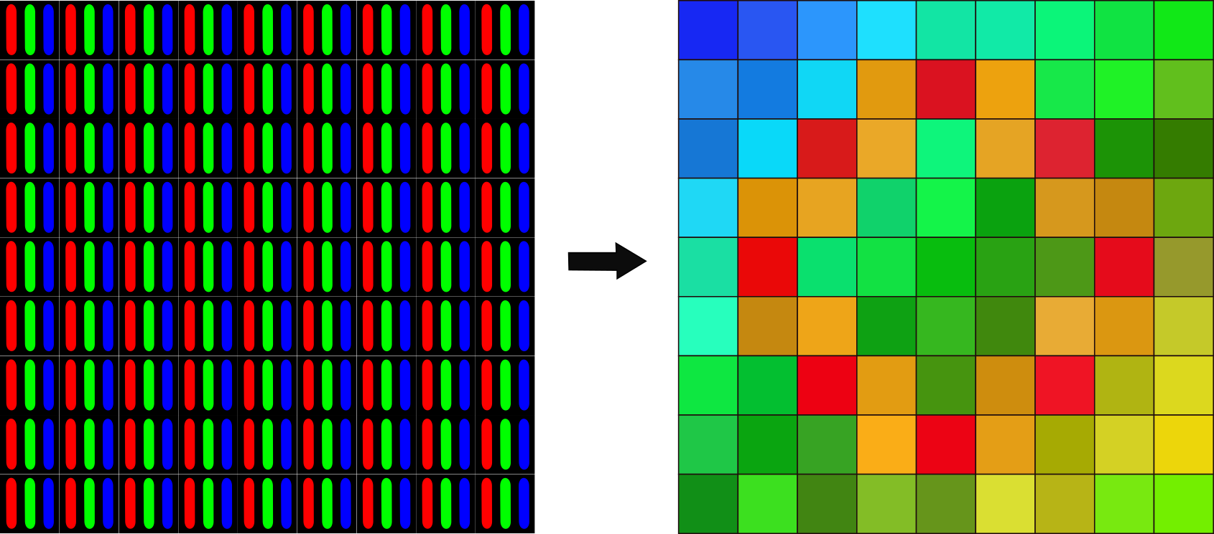
(X=0,Y=0)
(X=0,Y=0)
(X=0,Y=0)
(X=0,Y=0)

Slide 9
(X,Y)
(X,Y)
(X+width,Y+height)
(X+width,Y+height)
image_original = Image.open("beach.jpg")
image_new = Image.new("RGB", image_original.size)
width, height = image_original.size
(X,Y)
pixels_original1 = image_original.load()
pixels_new = image_new.load()
r1, g1, b1 = pixels_original[x, y]
r1 = r1 + 100
pixels_new[x, y] = (r1, g1, b1)

Slide 10
(X,Y)
(X,Y)
(X,Y)
(X+width,Y+height)
(X+width,Y+height)
(X+width,Y+height)
image_original = Image.open("beach.jpg")
image_original = Image.open(“catus.jpg")
image_new = Image.new("RGB", image_original.size)
width, height = image_original.size
width, height = image_original.size
(X,Y)
pixels_original1 = image_original.load()
pixels_original2 = image_original.load()
pixels_new = image_new.load()
r1, g1, b1 = pixels_original[x, y]
r2, g2, b2 = pixels_original[x, y]
pixels_new[x, y] = (r3, g3, b3)
LOGIC: "if g is greater than something and r and b are less than something else, do the following." ***Hint copy either pixel 1 or pixel 2 into new

Slide 11
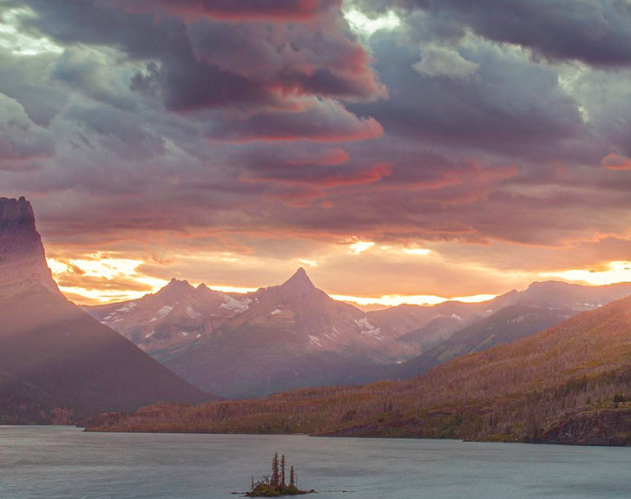
How THIS wallpaper kills your phone
Video: https://www.youtube.com/watch?v=iXKvwPjCGnY

